Slide 1
FIFA World Cup Data Analysis

Slide 2


Slide 3
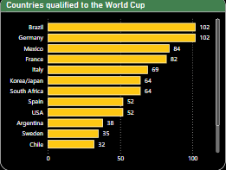
Countries Qualified to World Cup

Slide 4
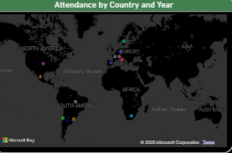
Attendance By Country and Year

Slide 5
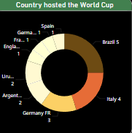
Country hosted the World Cup

Slide 6
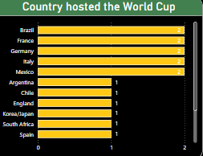
Country hosted the World Cup

